Slide 1
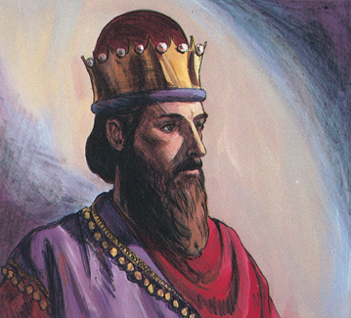
Profitless Pursuits
Ecclesiastes 1:12–2:11
Dr. Rick Griffith • Crossroads International Church Singapore
CICFamily.com • BibleStudyDownloads.org

Slide 2
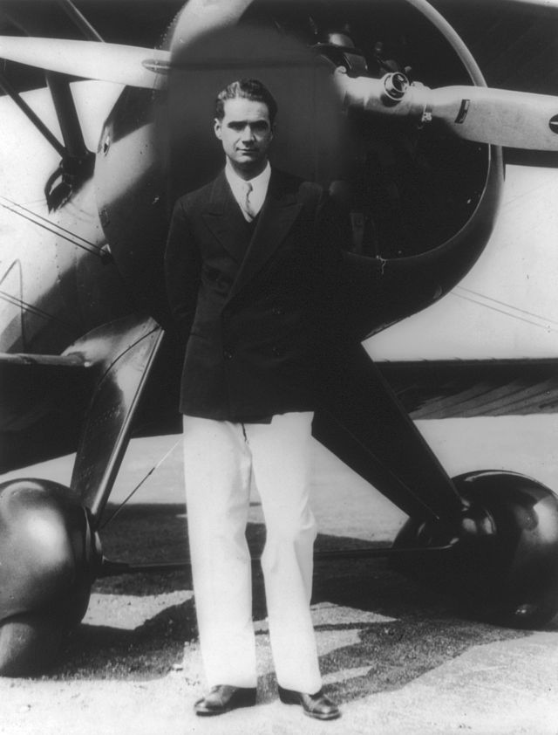
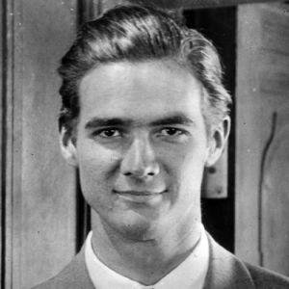
Howard Hughes (1905-1976)
Notes:
Howard Hughes, Jr. (December 24, 1905 – April 5, 1976) was an American businessman, investor, aviator, aerospace engineer, film maker and philanthropist. He was one of the wealthiest people in the world.

Slide 3

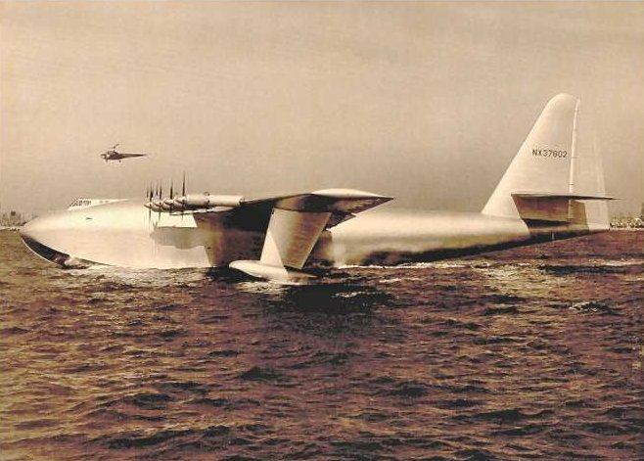
H-4 Hercules 2
Notes:
He is best known for his interest in aviation, having founded Hughes Aircraft. This company sought to help the WWII effort by making the largest plane in history designed to transport 700 troops across the Atlantic.

Slide 4
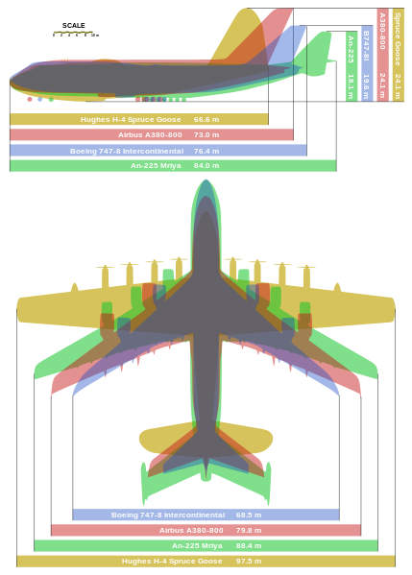
H-4 Hercules 2 had the longest wingspan ever!
http://en.wikipedia.org/wiki/File:Giant_planes_comparison.svg
Notes:
Its wingspan was 97 meters, compared to the 80 meters of today's A380!
The other three planes are the (longest and heaviest) Russian transport An-225 (1988), A380, and B747.

Slide 5
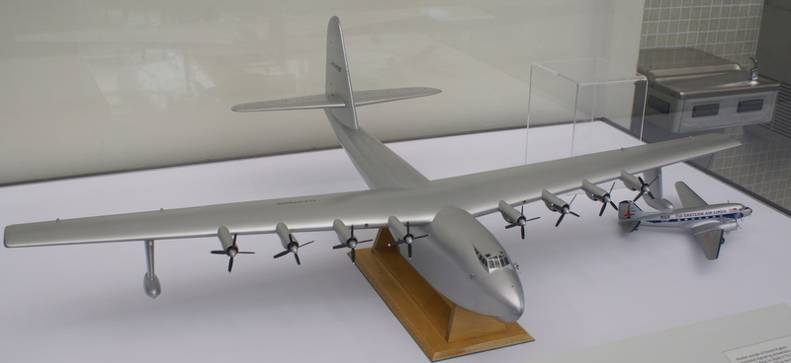
The "Spruce Goose" (1947)
Notes:
Unfortunately, the prototype wasn't finished until 1947—after the War had ended. It was dubbed "The Spruce Goose" even though it was made out of birch as War laws prohibited aluminum planes.

Slide 6
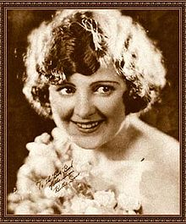
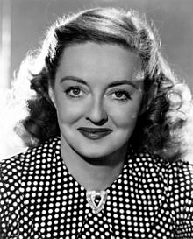
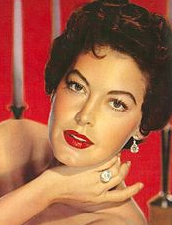
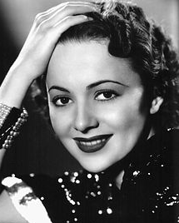
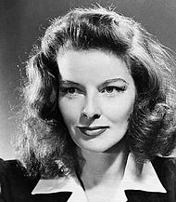
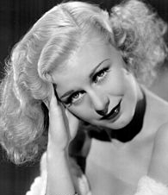
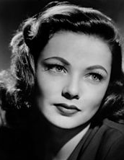
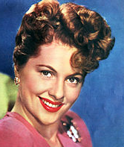
Women, Women, Women!
Billie Dove
Bette Davis
Ava Gardner
Olivia de Havilland
Katharine Hepburn
Gene Tierney
Joan Fontaine
Ginger Rogers
Notes:
"Hughes dated many famous women, including Billie Dove, Bette Davis, Ava Gardner, Olivia de Havilland, Katharine Hepburn, Ginger Rogers and Gene Tierney. He also proposed to Joan Fontaine several times" (wikipedia).

Slide 7
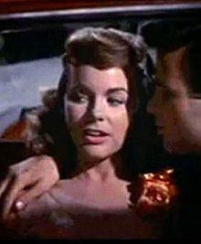
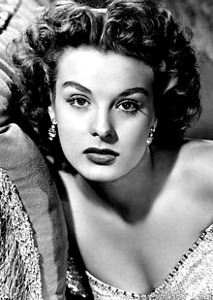
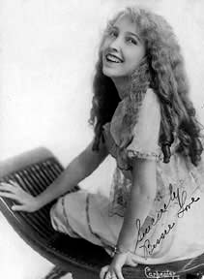
Jean Peters (3rd wife from 1957-71)
Terry Moore (disputed wife from 1949-76)
Bessie Love (mistress in his 1st marriage)
Notes:
Bessie Love was a mistress during his first marriage, but it's still unknown whether he was actually married to Terry Moore for 27 years! Jean Peters, his third wife, refused to talk about their marriage.

Slide 8
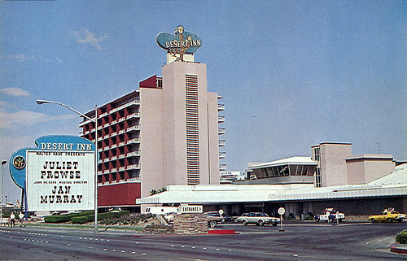
The Desert Inn, Las Vegas
Notes:
His obsessive compulsive behavior especially plagued Hughes in his later years. "On November 24, 1966 (Thanksgiving Day),^{[58]} Hughes arrived in Las Vegas by railroad car and moved into the Desert Inn. Because he refused to leave the hotel, and to avoid further conflicts with the owners, Hughes bought the Desert Inn in early 1967" (wikipedia).

Slide 9
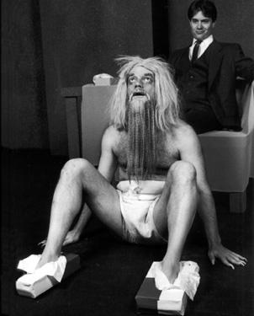
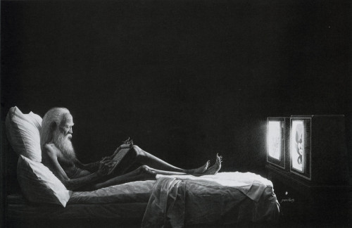
Howard Hughes (1905-1976)
Notes:
He spent most of his days living alone naked in his penthouse watching movies. He watched one movie 150 times!* "His reclusive activities (and possibly his drug use) made him practically unrecognizable; his hair, beard, fingernails, and toenails were long (possibly caused by [a disease] making him averse to touch), his tall 6 ft 4 in (193 cm) frame now weighed barely 90 pounds (41 kg)" (wikipedia) and he has a fixation with Kleenex boxes that he kept everywhere to keep from collecting germs.
* He became obsessed with the 1968 film Ice Station Zebra and had it running on a continuous loop in his home. According to his aides, he watched it 150 times (Wikipedia)

Slide 10
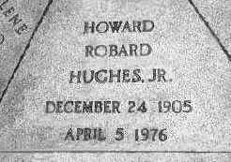
Howard Hughes
Notes:
"The FBI had to resort to fingerprints to identify the body… X-rays revealed five broken-off hypodermic needles in the flesh of his arms" (Wikipedia).

Slide 11
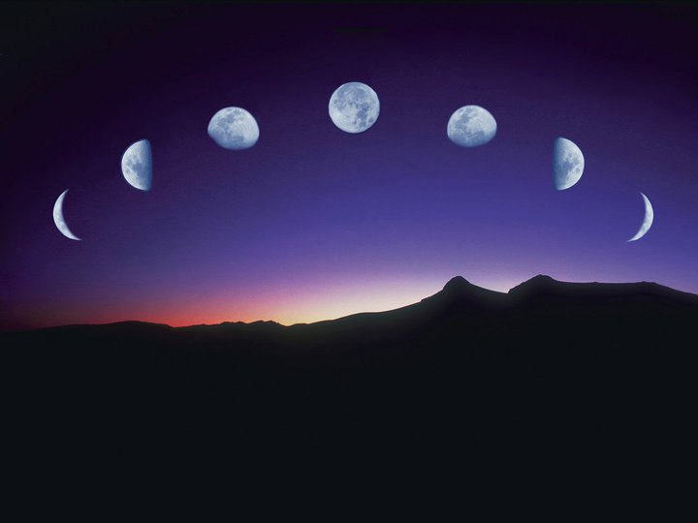
Our Study in Ecclesiastes
Work & Wisdom Don't Last

Slide 12
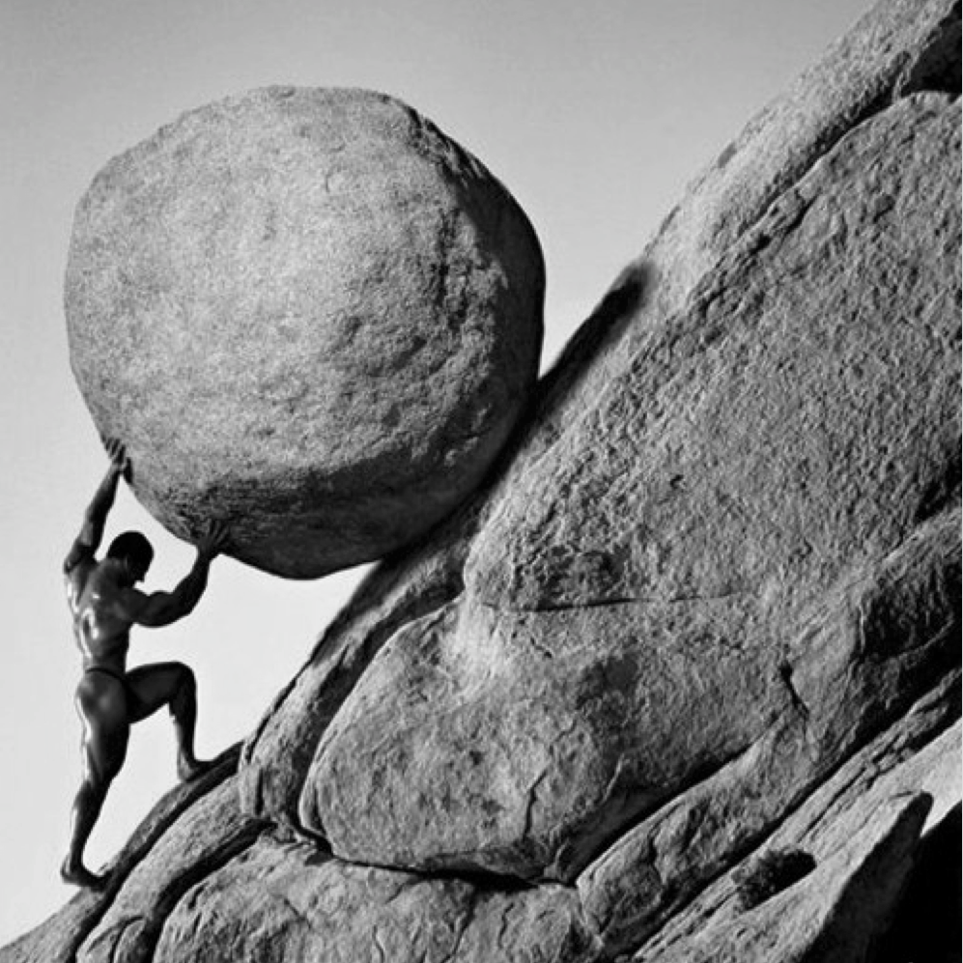
What are the profitless pursuits that we should avoid?
Ecclesiastes

Slide 13
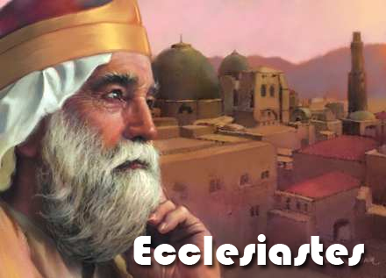
Solomon
"I, the Teacher, was king of Israel, and I lived in Jerusalem"
(1:12 NLT).
Ecclesiastes
Notes:
http://churchsermonseriesideas.com/?s=ecclesiastes image

Slide 14
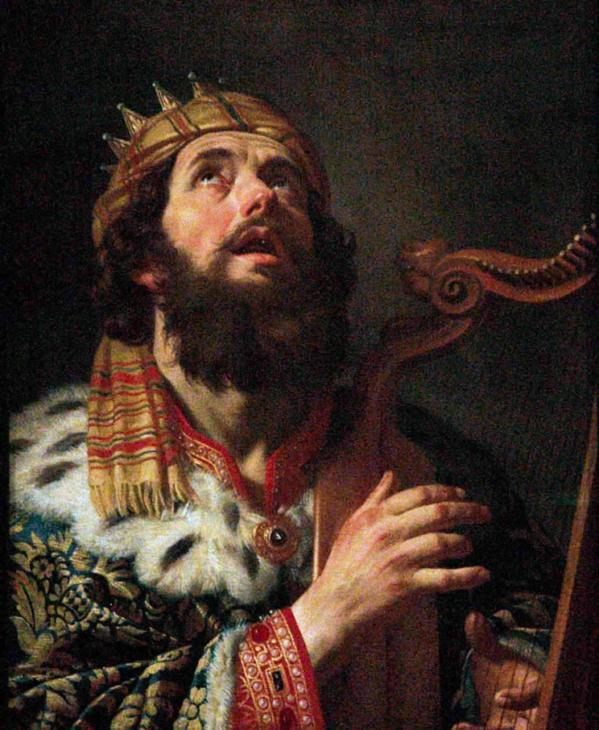
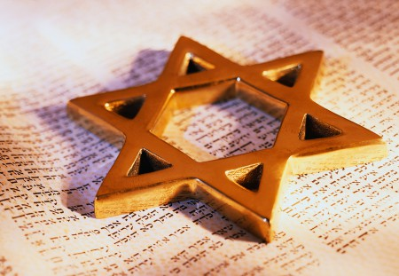
Israel's Golden Age

Slide 15
Grief
"I devoted myself to search for understanding and to explore by wisdom everything being done under heaven. I soon discovered that God has dealt a tragic existence to the human race"
(1:13 NLT).
Ecclesiastes
Notes:
http://churchsermonseriesideas.com/?s=ecclesiastes image

Slide 16
Fleeting
"I observed everything going on under the sun, and really, it is all meaningless—like chasing the wind"
(1:14 NLT).
Ecclesiastes
Notes:
http://churchsermonseriesideas.com/?s=ecclesiastes image

Slide 17
Profitless
"What is wrong cannot be made right.
What is missing cannot be recovered"
(1:15 NLT).
Ecclesiastes
Notes:
http://churchsermonseriesideas.com/?s=ecclesiastes image

Slide 18

Cover
Let's see 5 of them…
Profitless Pursuits
Under the Sun

Slide 19
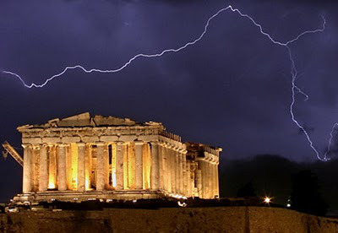
I. Prudence doesn't satisfy (1:16-18).
Notes:
I said to myself, "Look, I am wiser than any of the kings who ruled in Jerusalem before me. I have greater wisdom and knowledge than any of them." ¹⁷ So I set out to learn everything from wisdom to madness and folly. But I learned firsthand that pursuing all this is like chasing the wind.
Eccl. 1:18 The greater my wisdom, the greater my grief.
To increase knowledge only increases sorrow.

Slide 20
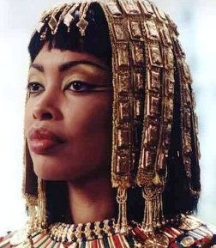

Many sought his wisdom

Slide 21
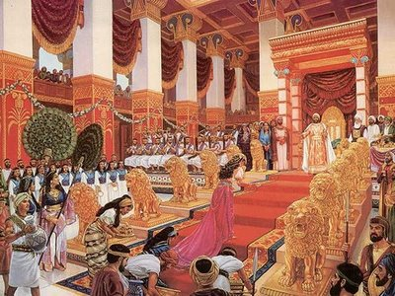
The Queen of Sheba
1 Kings 10:1 When the queen of Sheba heard of Solomon's fame, which brought honor to the name of the LORD, she came to test him with hard questions.

Slide 22
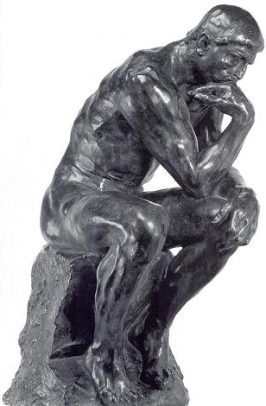

Wisdom is Fleeting
Wisdom
Pain
Doubt
Pride

Slide 23
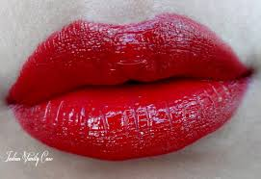

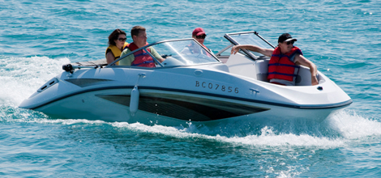
II. Pleasure doesn't satisfy (2:1-3).

Slide 24
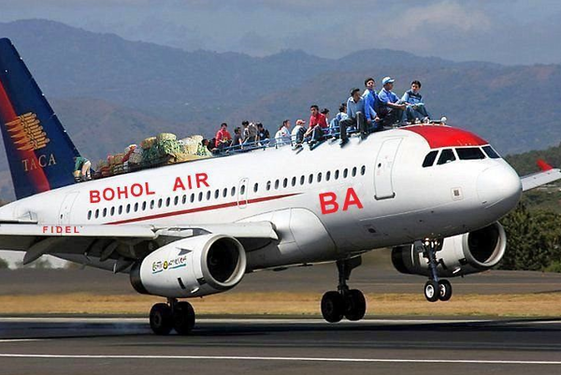
Solomon tried pleasure (2:1).
"I said to myself, 'Come on, let's try pleasure. Let's look for the 'good things' in life.' But I found that this, too, was meaningless"

Slide 25
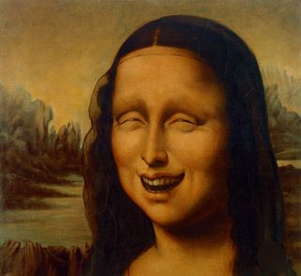
Solomon tried pleasure in humor (2:2).
"So I said, 'Laughter is silly. What good does it do to seek pleasure?'"

Slide 26

Solomon tried pleasure in humor (2:2).
I'M WITH STUPID
→
Verses
MILITARY HUMOR
You gotta love it…

Slide 27
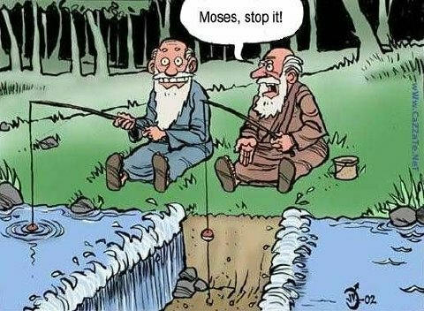
Moses, stop it!

Slide 28
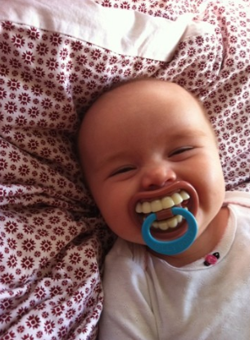
Christians ought to love to laugh!

Slide 29
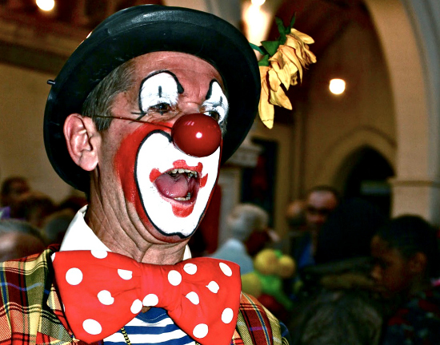
Garbonzo the Clown
Notes:
A man once went to a counselor to help him with his depression. Over the weeks the counselor tried many attempts to help him get out of his depression, but nothing worked. The man repeatedly came into his office with his head hanging low. Finally, one week the counselor advised, "Actually, my last bit of advice is this. Last week I took my family to the circus where we saw Garbonzo the clown. He is the funniest person I have ever seen. Why don't you buy a ticket and go to the show yourself?" The man still kept his head low and said, "I am Garbonzo the Clown!" Emptiness!

Slide 30
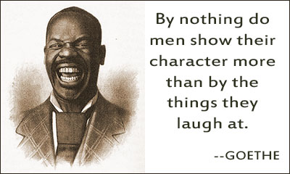
What do you laugh about?
"By nothing do men show their character more than by the things they laugh at."
—Goethe
Verses

Slide 31

Solomon tried pleasure in wine (2:3a NLT).
"After much thought, I decided to cheer myself with wine."

Slide 32

The secret to enjoying a good wine:
1. Open the bottle to allow it to breathe.
2. If it does not look like it's breathing, give it mouth-to-mouth.

Slide 33


Solomon tried pleasure in wine (2:3a NLT).
Wine a little.
It'll make
you feel better.

Slide 34
People say that drinking milk makes you stronger.
Drink 5 glasses of milk
and try to move a wall.
Can't?
Now drink 5 glasses of wine.
The wall moves all by itself!

Slide 35
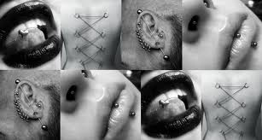

Solomon tried pleasure in foolishness (2:3b NLT).
"And while still seeking wisdom, I clutched at foolishness. In this way, I tried to experience the only happiness most people find during their brief life in this world."

Slide 36
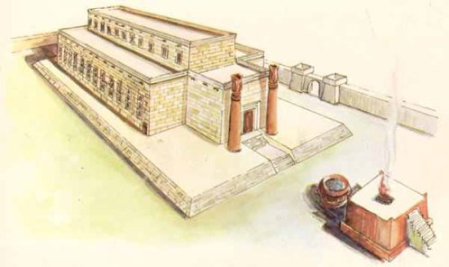
III. Projects don't satisfy (2:4-6).

Slide 37
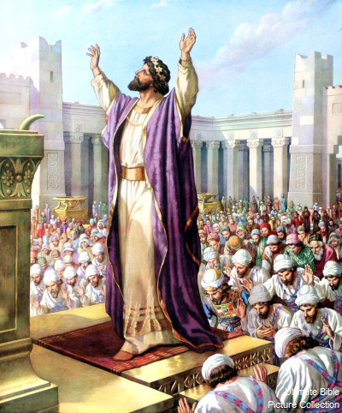
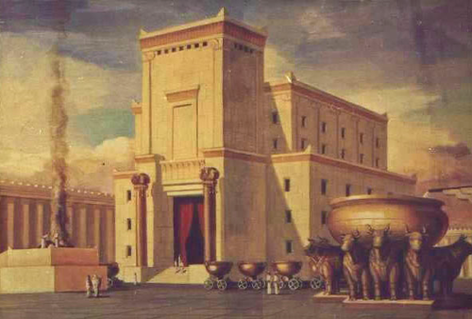
The temple was his greatest project

Slide 38

The Great Sea was supported by 12 oxen

Slide 39
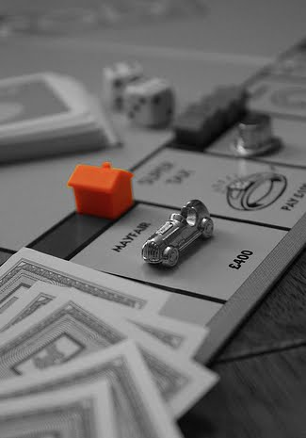
Homes
Projects Passionately Pursued
"I also tried to find meaning by building huge homes for myself…"
(4a NLT)
Notes:
Solomon built homes for himself (2:4a; 1 Kings 7:1-12)

Slide 40
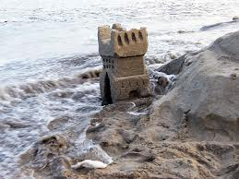
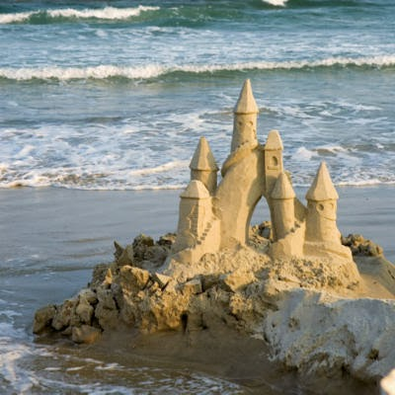
Homes
Projects Passionately Pursued
"I also tried to find meaning by building huge homes for myself…"
(4a NLT)
Notes:
Solomon built homes for himself (2:4a; 1 Kings 7:1-12)

Slide 41
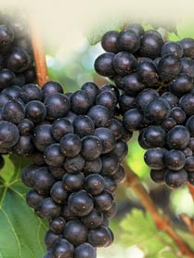
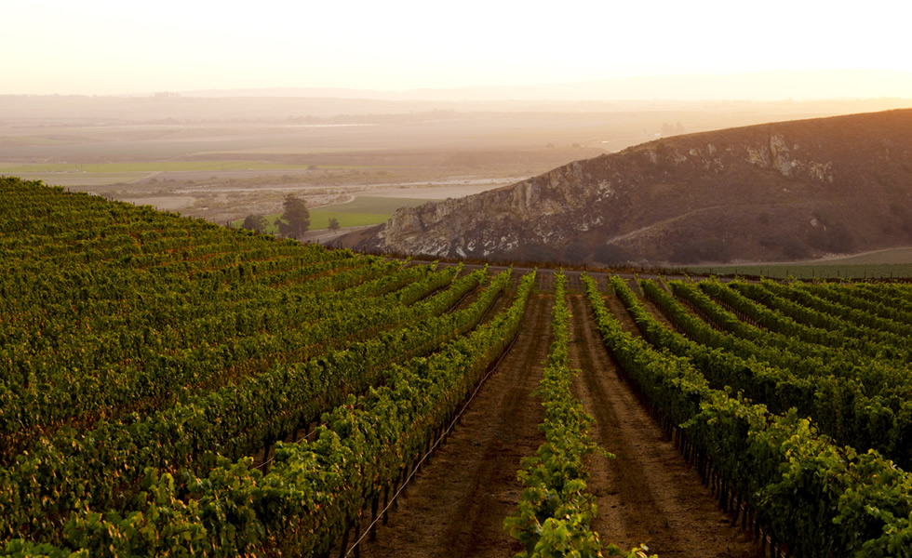
Vineyards
Projects Passionately Pursued
"I also tried to find meaning by…planting beautiful vineyards"
(2:4b NLT).
Notes:
Solomon planted vineyards for himself (2:4b; Song of Solomon 8:10-11)

Slide 42
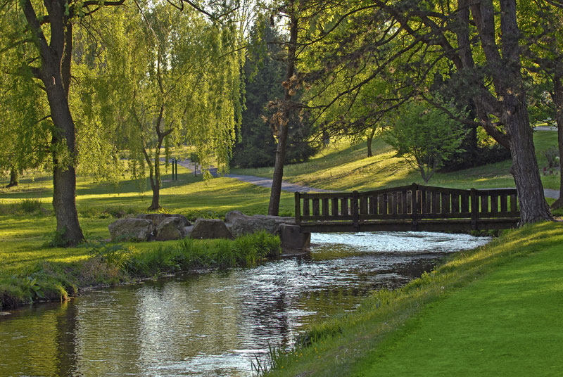
Gardens & Parks
Projects Passionately Pursued
"I made gardens and parks" (2:5a NLT).
Notes:
Solomon made gardens and parks for himself (2:5a)

Slide 43
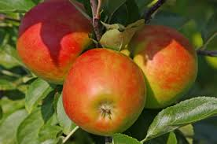
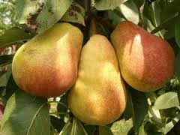


Food
Projects Passionately Pursued
"…filling them with all kinds of fruit trees" (2:5b NLT).
Notes:
Solomon produced food for himself (2:5b)

Slide 44

Ponds
Projects Passionately Pursued
"I built reservoirs to collect the water to irrigate my many flourishing groves" (2:6 NLT).
Notes:
Solomon built irrigation ponds for himself (2:6; Neh. 2:14; 3:15,16)

Slide 45
PRIDE
The most used word…

Slide 46

IV. Possessions don't satisfy (2:7-8).

Slide 47

Winning?

Slide 48

Slaves & Servants
"I bought slaves, both men and women, and others were born into my household" (2:7 NLT).
Possessions

Slide 49

Flocks & Herds
"I also owned large herds and flocks, more than any of the kings who had lived in Jerusalem before me"
(2:7b NLT).
Possessions

Slide 50

Flocks & Herds

Slide 51

Money
"I collected great sums of silver and gold, the treasure of many kings and provinces" (2:8a NLT).
Possessions

Slide 52

Money
"Each year Solomon received about 25 tons of gold. This did not include the additional revenue he received from merchants and traders, all the kings of Arabia, and the governors of the land" (1 Kings 10:14-15).
Possessions

Slide 53

More Money = More Happiness?
Ecclesiastes
MORE, MORE, MORE!!!
CREDIT
DEEPER & DEEPER
IN DEBT
USA

Slide 54

Musicians
"I hired wonderful singers, both men and women…" (2:8b NLT).
Possessions

Slide 55

1000 women!
"…I had many beautiful concubines.
I had everything a man could desire!"
(2:8c NLT).
Possessions

Slide 56

Solomon's Wives
Ooops. Wrong picture uploaded.
Notes:
In the Hebrew mind, seven is the perfect number!

Slide 57


Women and money turned Solomon's heart away

Slide 58


More Women = More Happiness?

Slide 59

V. Power doesn't satisfy (2:9).
"So I became greater than all who had lived in Jerusalem before me, and my wisdom never failed me."

Slide 60

"Anything I wanted, I would take. I denied myself no pleasure. I even found great pleasure in hard work, a reward for all my labors. ¹¹ But as I looked at everything I had worked so hard to accomplish, it was all so meaningless—like chasing the wind. There was nothing really worthwhile anywhere."
Profitless Pursuits Conclusion (2:10-11 NLT)

Slide 61

Our pursuits never profit.
Main Idea of 1:12–2:11

Slide 62
Hebel literally means
"a breath, wind, or vapor"
(Prov. 21:6; Isa. 57:13).
The Key Word of Ecclesiastes

Slide 63
Cover
Prudence
Pleasure
Projects
Possessions
Power
Profitless Pursuits
Under the Sun

Slide 64

1:2 KJV
The Hebrew Word Hebel
Vanity of vanities!
all is vanity!

Slide 65


Meaning of Hebel
lbh
"vanity" (KJV, ESV, NAU), "meaningless" (NIV, NLT), "futile" (NET, TLB, BKC)
"fleeting"
The Key Word of Ecclesiastes

Slide 66

A Very Literal Translation
Metaphor:
what doesn't last —"what is without real substance, value, permanence, significance, or meaning" (BKC, 1:976)

Slide 67

Opposite Directions at 29:13
Isaiah 29:13
"And so the Lord says, 'These people say they are mine. They honor me with their lips, but their hearts are far from me. And their worship of me is nothing but man-made rules learned by rote.'"
Jeremiah 29:13
"If you look for me wholeheartedly, you will find me."
Seeking Self
Seeking God

Slide 68
Black

Slide 69


OT Preaching link at BibleStudyDownloads.org
Get this presentation and script for free!

